Slide 1
Data Pre-Processing
and
Exploratory Data Analysis
Date : 31st May 2020 | Speaker : Ayon Roy
Visit - AYONROY.ML

Slide 2

Hello Buddy!
I am Ayon Roy
B.Tech CSE ( 2017-2021 )
Data Science Intern @ Lulu International Exchange, Abu Dhabi
( World’s Leading Financial Services Company )
Brought Kaggle Days Meetup Community in India for the 1st time
Visit - AYONROY.ML

Slide 3
Agenda ( 31-5-2020 )
What is Data Pre-Processing ( DPP ) ?
Why do we need it ?
Major Steps in DPP
What is Exploratory Data Analysis ( EDA ) ?
Why do we need it ?
What are the types of EDA ?
A few EDA Approaches
Major steps in EDA
Visit - AYONROY.ML

Slide 4


Slide 5

Visit - AYONROY.ML

Slide 6
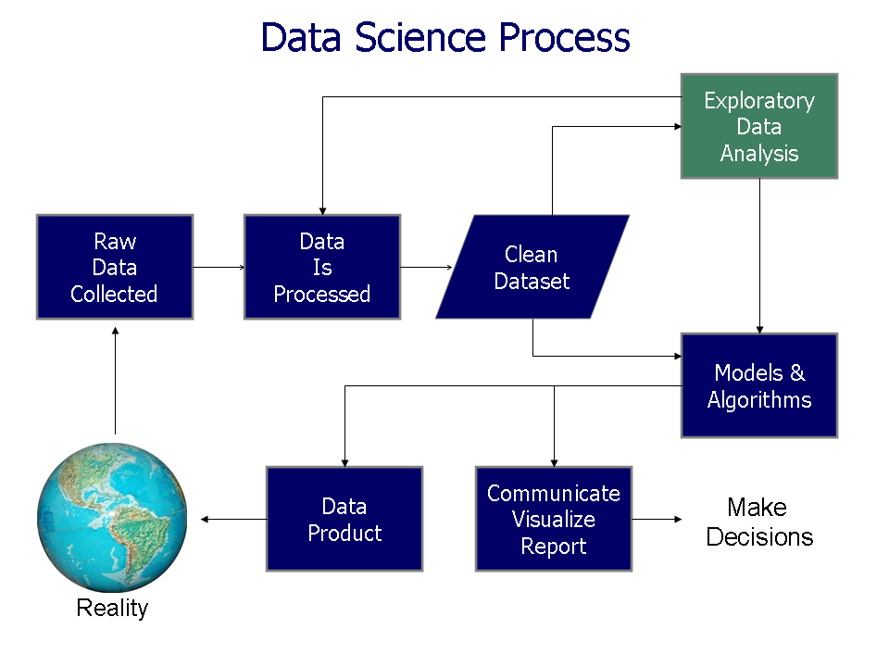
Visit - AYONROY.ML

Slide 7
It is a technique that transforms raw data into an understandable format.
What is
Data Pre-Processing ?
Visit - AYONROY.ML

Slide 8
Why do we need it ?
Raw data ( Real world data ) is always messy and that data cannot be sent through a model. That would cause certain errors.
So we need to preprocess data before sending through further analysis.
Visit - AYONROY.ML

Slide 9

Visit - AYONROY.ML

Slide 10

Steps to be followed
Visit - AYONROY.ML

Slide 11
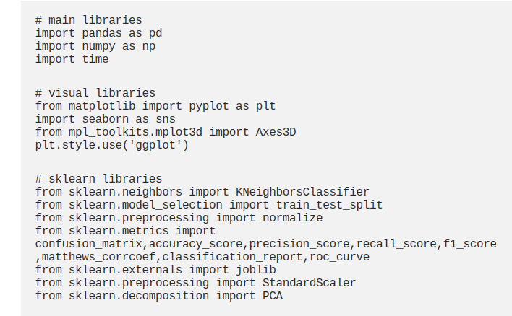
Get the data & Import the Libraries
Visit - AYONROY.ML

Slide 12
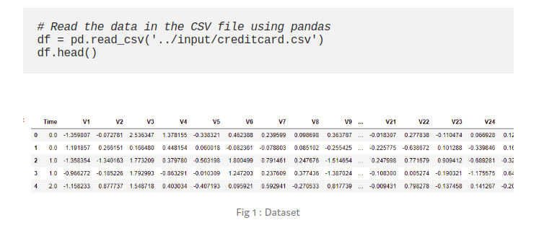
Read the data
Visit - AYONROY.ML

Slide 13
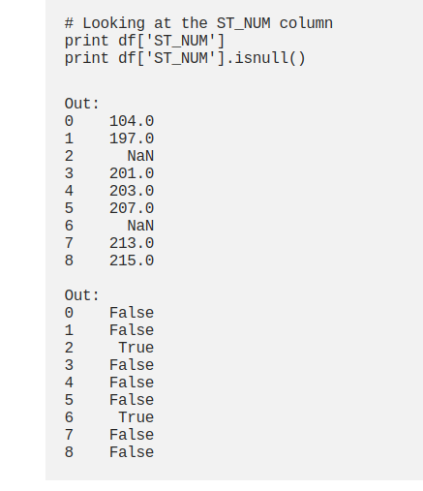
Checking the Missing Values
Visit - AYONROY.ML

Slide 14
Remove the Missing Values
Is it a Good idea ?
Can we do something for this ?
Visit - AYONROY.ML

Slide 15
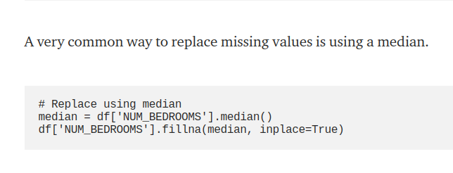
Replacing the Missing Values
Visit - AYONROY.ML

Slide 16
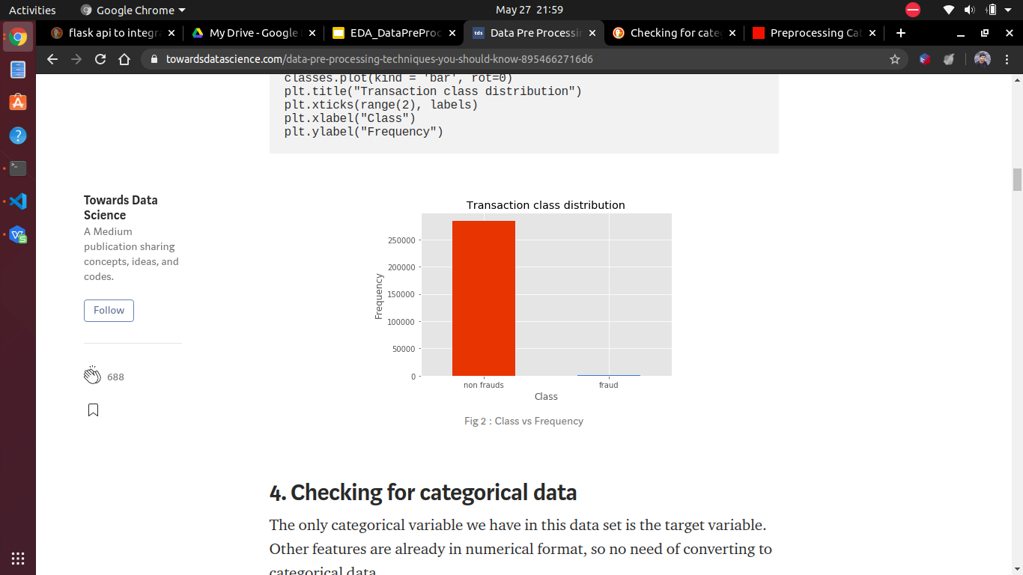
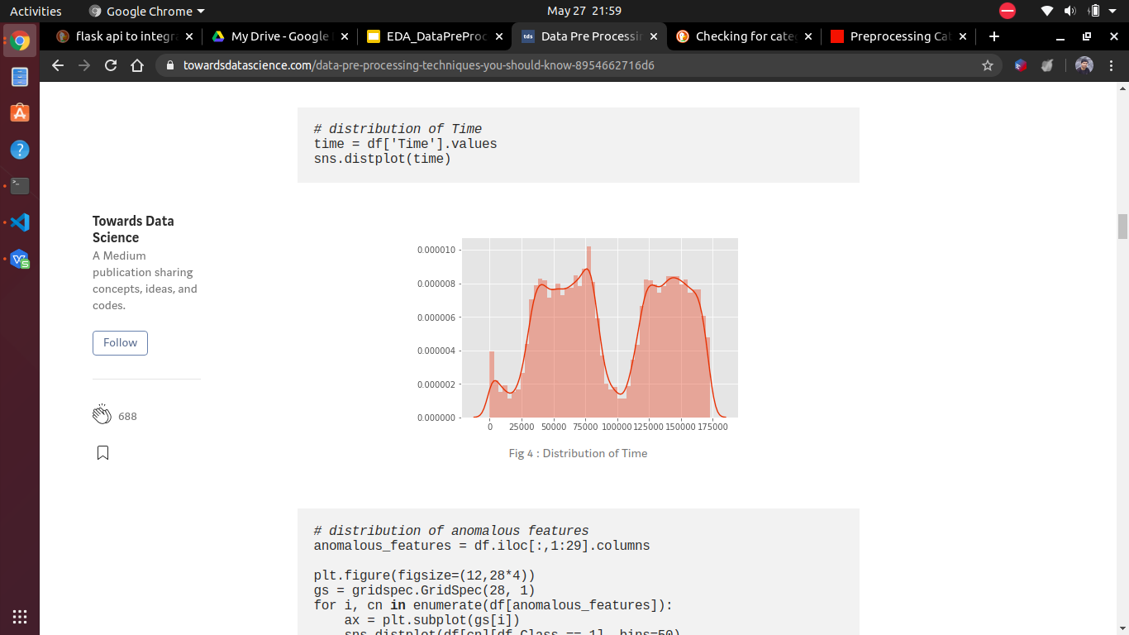
Exploring
Numerical Data & Categorical Data
Visit - AYONROY.ML

Slide 17
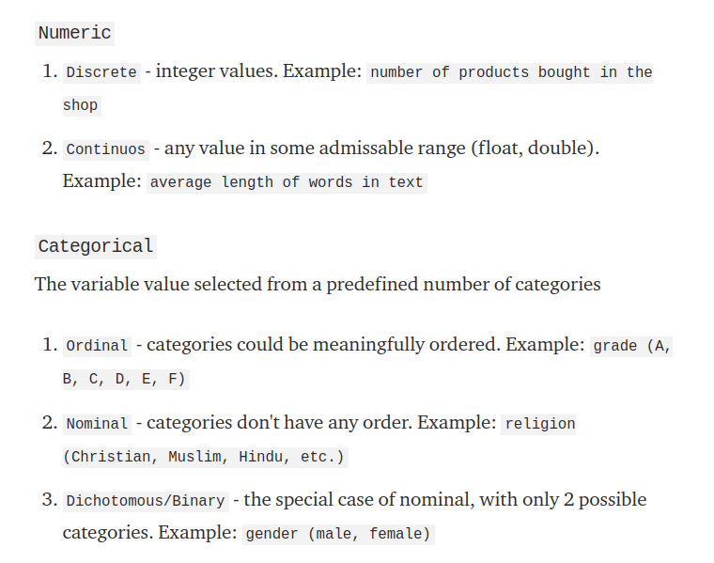
Numerical Data
&
Categorical Data
Visit - AYONROY.ML

Slide 18
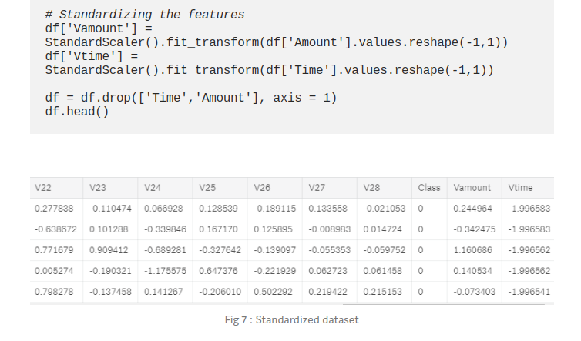
Standardizing the data
Visit - AYONROY.ML

Slide 19
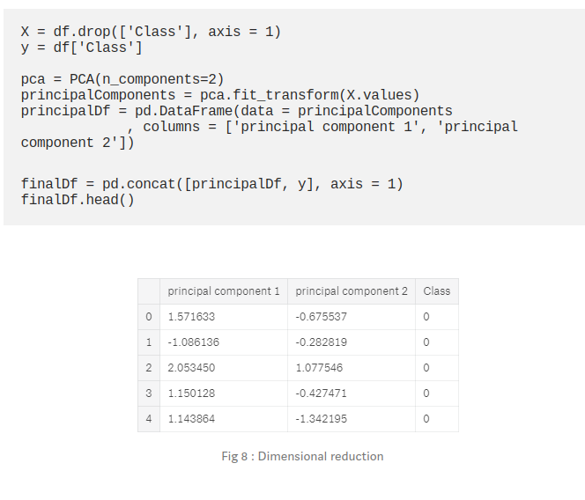
Data Transformations ( Like PCA )
PCA (Principal Component Analysis) mainly using to reduce the size of the feature space while retaining as much of the information as possible.
Visit - AYONROY.ML

Slide 20
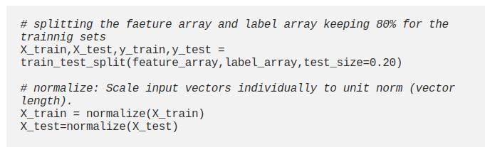
Data Splitting
Visit - AYONROY.ML

Slide 21
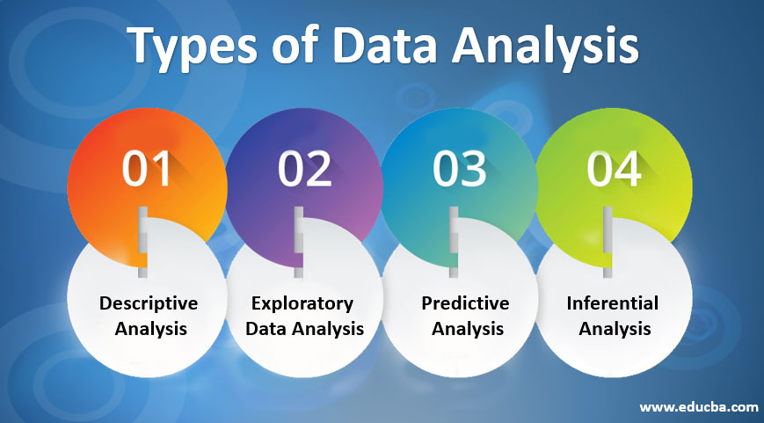
￼
Visit - AYONROY.ML

Slide 22

￼
Exploratory Data Analysis
Visit - AYONROY.ML

Slide 23
What is Exploratory Data Analysis ?
A critical process of performing initial investigations on data so as to discover patterns,to spot anomalies,to test hypothesis and to check assumptions with the help of summary statistics and graphical representations.
Visit - AYONROY.ML

Slide 24
Why do we need it ?
Detection of mistakes & missing data
Checking of assumptions
Preliminary selection of appropriate models
Determining relationships among the explanatory variables
With EDA, we can make sense of the data we have and then figure out what questions we want to ask and how to frame them
Visit - AYONROY.ML

Slide 25
Types of Exploratory Data Analysis
Visit - AYONROY.ML

Slide 26
Univariate Non-Graphical EDA
Concerned with understanding the underlying sample distribution and make observations about the population.
This also involves Outlier detection. We use the measures of central tendency like Mean, Median, Mode & measures of spread like Variance, Standard Deviation
Visit - AYONROY.ML

Slide 27
Univariate Graphical EDA
Histograms are used to represent the frequency with bins chosen to depict the central tendency, spread, modality, shape and outliers.
Boxplots can also be used to present information about the central tendency, symmetry and skew, as well as outliers.
Visit - AYONROY.ML

Slide 28
Multivariate Non-Graphical EDA
Used to show the relationship between two or more variables in the form of either cross-tabulation or statistics.
We can calculate covariance and/or correlation and assemble them into a matrix.
Visit - AYONROY.ML

Slide 29
Multivariate Graphical EDA
We use barplot with each group representing one level of one of the variables and each bar within a group representing the levels of the other variable.
We also use scatter plot which has one variable on the x-axis, one on the y-axis and a point for each case in your dataset. Typically, the explanatory variable goes on the X axis.
Visit - AYONROY.ML

Slide 30
A few EDA Approaches
Visit - AYONROY.ML

Slide 31
Clustering and dimension reduction techniques, which help you to create graphical displays of high-dimensional data containing many variables;
Univariate visualization of each field in the raw dataset, with summary statistics;
Bivariate visualizations and summary statistics that allow you to assess the relationship between each variable in the dataset and the target variable you’re looking at;
Multivariate visualizations, for mapping and understanding interactions between different fields in the data;
K-Means Clustering (creating “centres” for each cluster, based on the nearest mean);
Predictive models, e.g. linear regression.
Visit - AYONROY.ML

Slide 32
Major Steps to be followed
Visit - AYONROY.ML

Slide 33
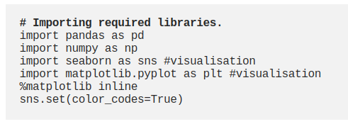
Import the Libraries
Visit - AYONROY.ML

Slide 34
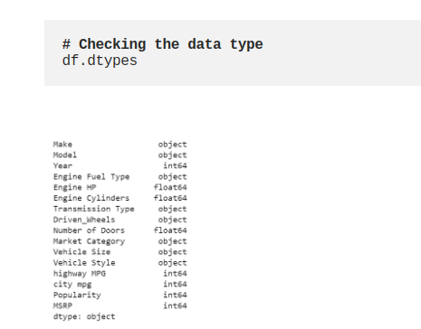
Check the type of Data
Visit - AYONROY.ML

Slide 35
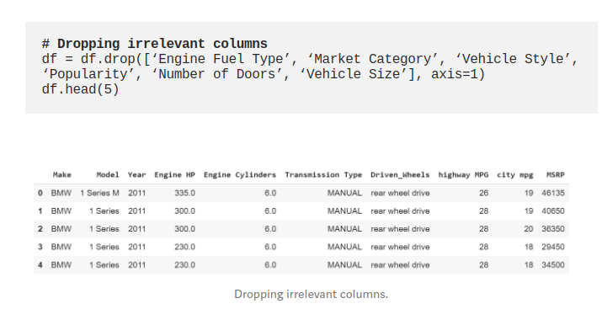
Dropping Irrelevant Columns
Visit - AYONROY.ML

Slide 36
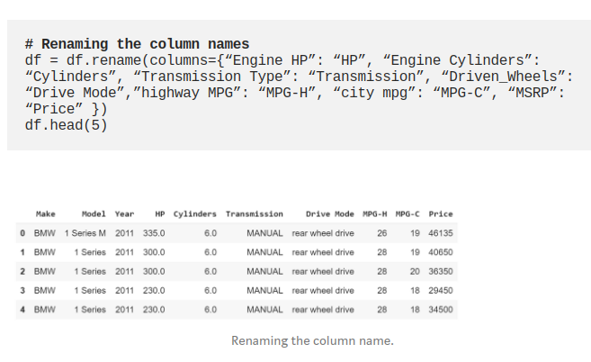
Renaming the Columns
Visit - AYONROY.ML

Slide 37
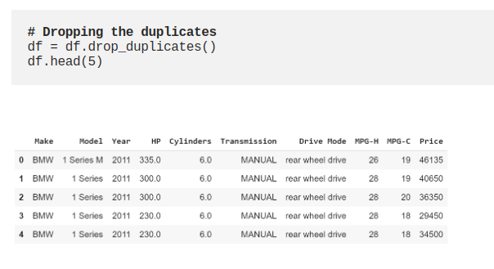
Removing the Duplicates
Visit - AYONROY.ML

Slide 38
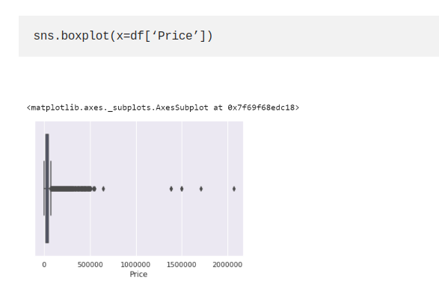
Detecting the Outliers
Visit - AYONROY.ML

Slide 39
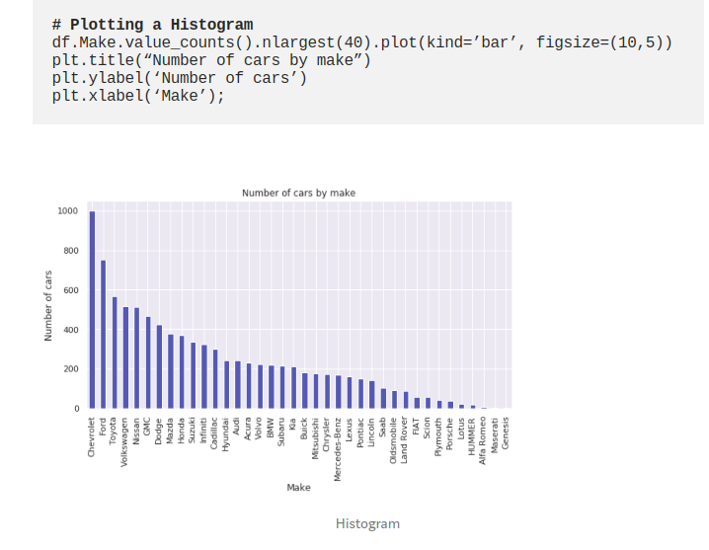
Plotting different features
Visit - AYONROY.ML

Slide 40
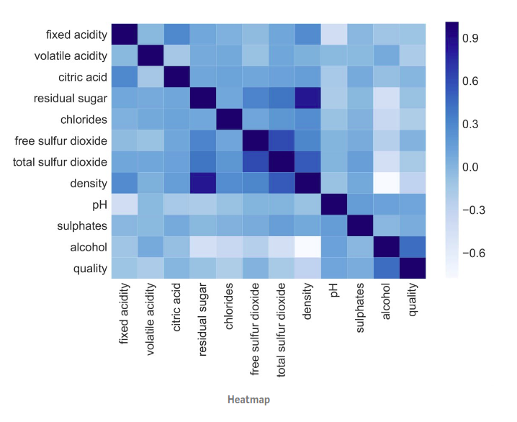
Heatmaps
Visit - AYONROY.ML

Slide 41
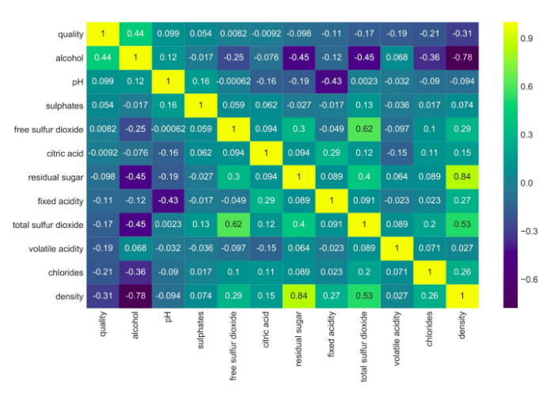
Correlation Matrix etc.
Visit - AYONROY.ML

Slide 42

Visit - AYONROY.ML

Slide 43

Let me answer your Questions now.
Finally, it’s your time to speak.
Visit - AYONROY.ML

Slide 44
Danke Scheon
Questions ? Any Feedbacks ? Did you like the talk?
Tell me about it.
If you think I can help you,
connect with me via
Email : ayonroy2000@outlook.com
LinkedIn / Github / Telegram Username : @ayonroy2000
Website : https://ayonroy.ml/

